Slide 1
Computer Security Cryptography (3/3)
by Akkradach W.
Dept. of Computer Engineering
KMITL

Slide 2
Key Distribution Problems
Too many parties = Too many keys
Key Distribution Center … how to trust?
Secure communication w/ strangers?

Slide 3
Public Key Cryptography
Number Theory
Modular Arithmetic
Prime numbers
RSA
Encryption/Decryption
Digital Signatures
The Solutions

Slide 4

Modular Arithmetic
n ∈ Z⁺, n ≥ 2
x ∈ Z
x modulo n
x mod n
x (mod n)
x (mod 12)
0 ≡ 12 ≡ 24 ≡ 36 …
1 ≡ 13 ≡ 25 ≡ 37 …
-1 ≡ 11, -2 ≡ 10, -3 ≡ 9 …

Slide 5
Modular Addition: x + y (mod 10)
+ | 0 | 1 | 2 | 3 | 4 | 5 | 6 | 7 | 8 | 9
0 | 0 | 1 | 2 | 3 | 4 | 5 | 6 | 7 | 8 | 9
1 | 1 | 2 | 3 | 4 | 5 | 6 | 7 | 8 | 9 | 0
2 | 2 | 3 | 4 | 5 | 6 | 7 | 8 | 9 | 0 | 1
3 | 3 | 4 | 5 | 6 | 7 | 8 | 9 | 0 | 1 | 2
4 | 4 | 5 | 6 | 7 | 8 | 9 | 0 | 1 | 2 | 3
5 | 5 | 6 | 7 | 8 | 9 | 0 | 1 | 2 | 3 | 4
6 | 6 | 7 | 8 | 9 | 0 | 1 | 2 | 3 | 4 | 5
7 | 7 | 8 | 9 | 0 | 1 | 2 | 3 | 4 | 5 | 6
8 | 8 | 9 | 0 | 1 | 2 | 3 | 4 | 5 | 6 | 7
9 | 9 | 0 | 1 | 2 | 3 | 4 | 5 | 6 | 7 | 8

Slide 6
Modular Addition: Additive Inverse
x + (-x) ≡ 0 (mod n)
4 + (6) ≡ 0 (mod 10)
EnKey=4, DeKey=6
Encipher: m+4 ≡ c (mod 10)
Decipher: c+6 ≡ m (mod 10)
Sound? Indeed
Safe? Definitely NOT

Slide 7
Modular Multiplication: x ⋅ y(mod 10)
⋅ | 0 | 1 | 2 | 3 | 4 | 5 | 6 | 7 | 8 | 9
0 | 0 | 0 | 0 | 0 | 0 | 0 | 0 | 0 | 0 | 0
1 | 0 | 1 | 2 | 3 | 4 | 5 | 6 | 7 | 8 | 9
2 | 0 | 2 | 4 | 6 | 8 | 0 | 2 | 4 | 6 | 8
3 | 0 | 3 | 6 | 9 | 2 | 5 | 8 | 1 | 4 | 7
4 | 0 | 4 | 8 | 2 | 6 | 0 | 4 | 8 | 2 | 6
5 | 0 | 5 | 0 | 5 | 0 | 5 | 0 | 5 | 0 | 5
6 | 0 | 6 | 2 | 8 | 4 | 0 | 6 | 2 | 8 | 4
7 | 0 | 7 | 4 | 1 | 8 | 5 | 2 | 9 | 6 | 3
8 | 0 | 8 | 6 | 4 | 2 | 0 | 8 | 6 | 4 | 2
9 | 0 | 9 | 8 | 7 | 6 | 5 | 2 | 3 | 2 | 1

Slide 8
Modular Multiplication: Multiplicative Inverse
x ⋅ (x⁻¹) ≡ 1 (mod n)
7 ⋅ (3) ≡ 1 (mod 10)
EnKey=7, DeKey=3
Encipher: m⋅7 ≡ c (mod 10)
Decipher: c⋅3 ≡ m (mod 10)
Sound? Useable Keys = {1, 3, 7, 9}
Safe? Nope – Euclid’s Algorithm

Slide 9
Relatively Prime and φ(n)
Relatively primes to n have multiplicative inverse (mod n)
GCD(x, n) = 1; x < n
1, 3, 7, and 9 are relatively prime to 10
Totient function: φ(n)
|{x∈Z⁺ ∧ x<n|GCD(x,n)=1}|
φ(10) = |{1,3,7,9}| = 4
If n is prime, φ(n) = |{1,2,3,…,n-1}| = n-1
If p and q are prime and n=pq,
φ(pq) =|{1,2,…,(pq)-1}|=pq-(p+q-1)=(p-1)(q-1)

Slide 10
Modular Exponentiation: x^{y} (mod 10)
x^{y} | 0 | 1 | 2 | 3 | 4 | 5 | 6 | 7 | 8 | 9 | 10 | 11 | 12
0 |  | 0 | 0 | 0 | 0 | 0 | 0 | 0 | 0 | 0 | 0 | 0 | 0
1 | 1 | 1 | 1 | 1 | 1 | 1 | 1 | 1 | 1 | 1 | 1 | 1 | 1
2 | 1 | 2 | 4 | 8 | 6 | 2 | 4 | 8 | 6 | 2 | 4 | 8 | 6
3 | 1 | 3 | 9 | 7 | 1 | 3 | 9 | 7 | 1 | 3 | 9 | 7 | 1
4 | 1 | 4 | 6 | 4 | 6 | 4 | 6 | 4 | 6 | 4 | 6 | 4 | 6
5 | 1 | 5 | 5 | 5 | 5 | 5 | 5 | 5 | 5 | 5 | 5 | 5 | 5
6 | 1 | 6 | 6 | 6 | 6 | 6 | 6 | 6 | 6 | 6 | 6 | 6 | 6
7 | 1 | 7 | 9 | 3 | 1 | 7 | 9 | 3 | 1 | 7 | 9 | 3 | 1
8 | 1 | 8 | 4 | 2 | 6 | 8 | 4 | 2 | 6 | 8 | 4 | 2 | 6
9 | 1 | 9 | 1 | 9 | 1 | 9 | 1 | 9 | 1 | 9 | 1 | 9 | 1

Slide 11
Modular Exponentiation: Useful properties
x^{y} (mod n) ≠ x^{y+n} (mod n)
x^{y} (mod n) ≡ x^{(y mod φ(n))} (mod n)
n must be square free!
y ≡ 1 (mod φ(n))

Slide 12
RSA: Rivest, Shamir, Adleman
Choose distinct prime numbers p and q
n = pq
φ(n) = (p-1)(q-1)
Choose e then d (w/ some conditions)
e ⋅ d ≡ 1 (mod φ(n))
e is public key exponent
d is private key exponent
As x^{ed} ≡ x (mod n) and m<n
Encipher: c ≡ m^{e} (mod n) ⟨e,n⟩ is public key
Decipher: m ≡ c^{d} (mod n) ⟨d,n⟩ is private key

Slide 13
Encryption/Decryption
Alice has
⟨e,n⟩ as PUBLIC key and announces it
⟨d,n⟩ as PRIVATE key and keeps it secret
Bob wants to send m to Alice securely
Bob uses Alice’s PUBLIC key to encipher
Alice gets the ciphertext from Bob
Alice uses Alice’s PRIVATE key to decipher

Slide 14
Digital Signatures
Alice wants to sign digital content then send to Bob
Alice computes MD from that content
Alice signs MD with her own PRIVATE key
Bob gets the digital content from Alice
Bob computes MD’ from received content
Bob computes MD from signed MD with Alice’s PUBLIC key
Bob compares MD with MD’

Slide 15
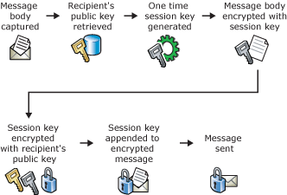

The Solutions (1)

Slide 16

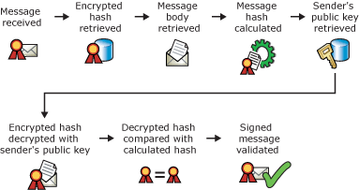
The Solutions (2)

Slide 17
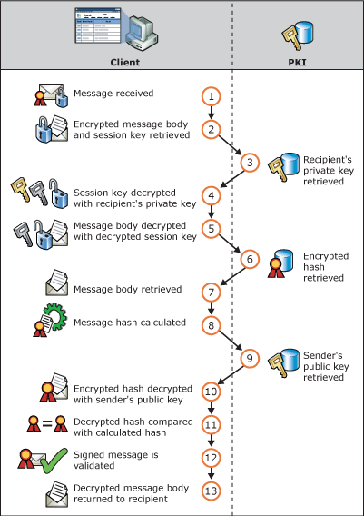
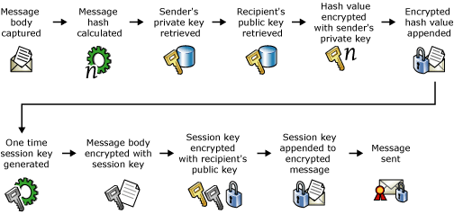
The Solutions (3)

Slide 18
The Solutions (4)
PKI
Certificates
CA
Root CA
Intermediate CA
CRL

